Slide 1
Text Mining & NLP

Slide 2
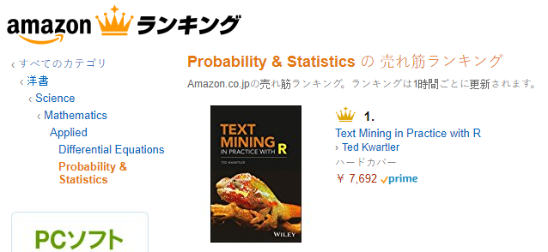

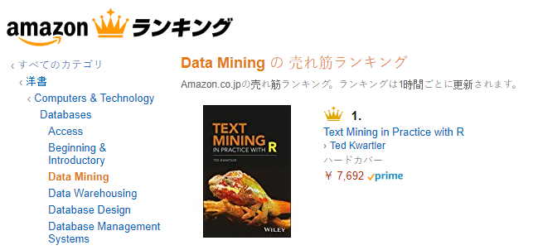

Shameless Plug #1

Slide 3


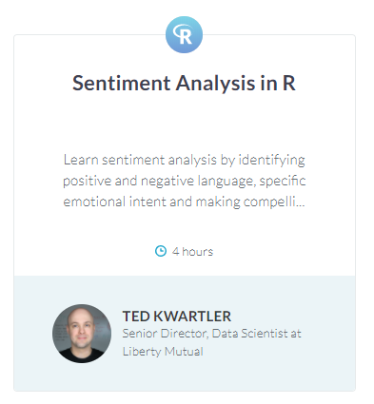
Shameless Plug #2

Slide 4
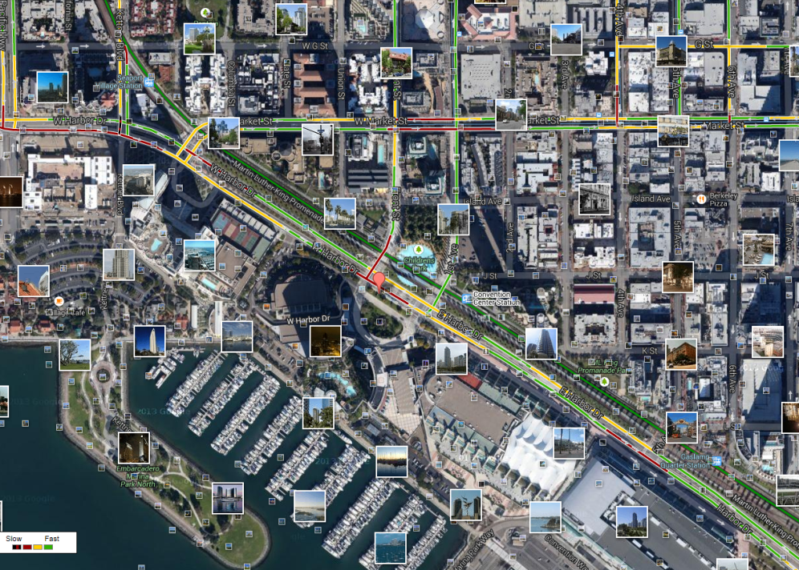
What is Text Mining?
Before Text Mining
Extract new insights from text
Let’s you drink from a fire hose of information
Language is hard; many unsolved problems
Unstructured
Expression is individualistic
Multi-language/cultural implications

Slide 5
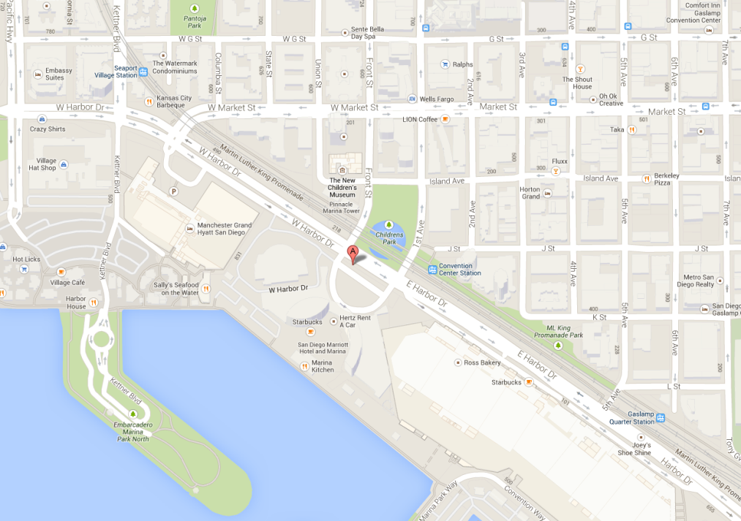
What is Text Mining?
After Text Mining
Extract new insights from text
Let’s you drink from a fire hose of information
Language is hard; many unsolved problems
Unstructured
Expression is individualistic
Multi-language/cultural implications

Slide 6
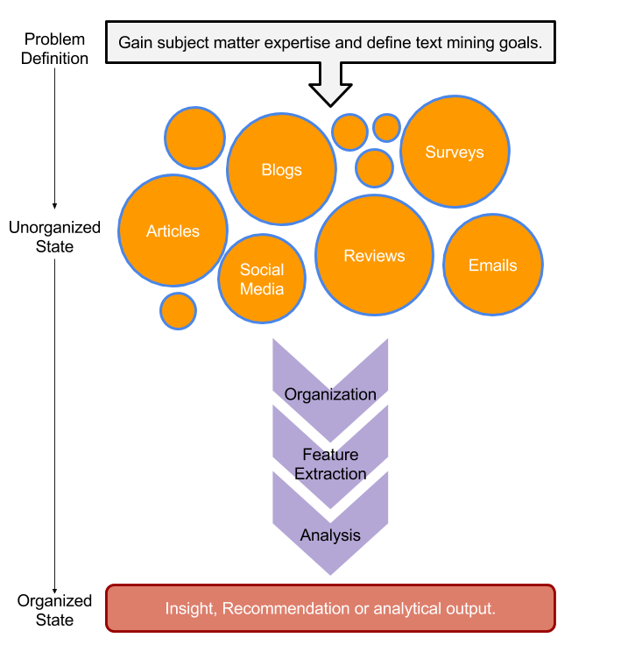
TM Project Workflow
Unorganized State
Natural Language Processing & Analysis
Organized State

Slide 7
Text Mining Workflow
Problem Definition
Identify Text Sources
Text Organization
Feature Extraction
Analytics
Reach Insight or Recommendation

Slide 8
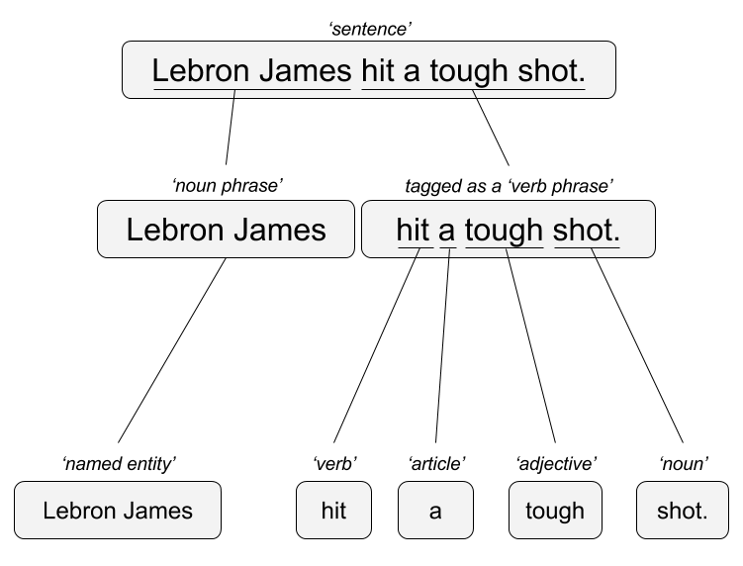

Two Popular Approaches
“Lebron James hit a tough shot.”
Syntactic Parsing
Bag of Words
Lebron
a
James
hit
tough
shot

Slide 9
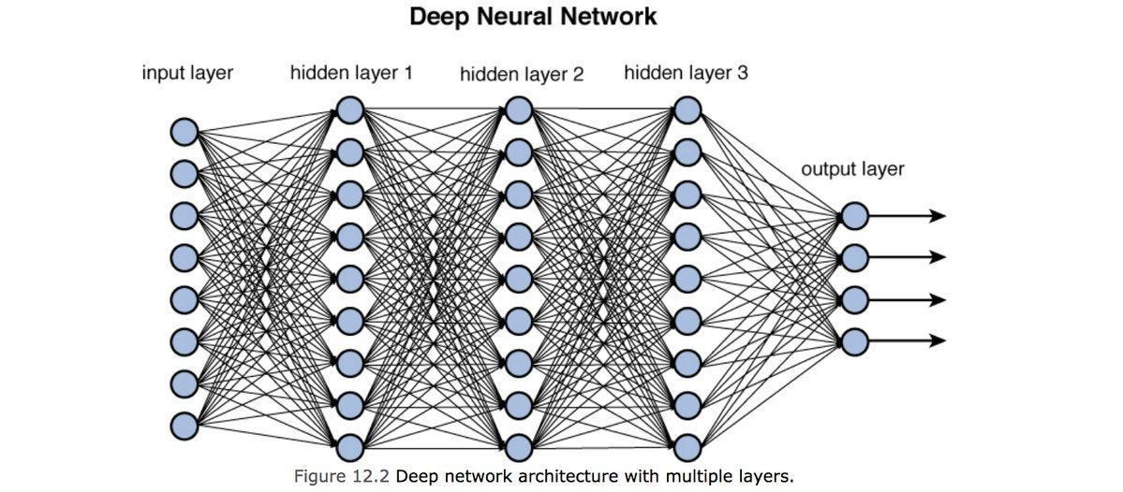
Ok, there is another method…

Slide 10
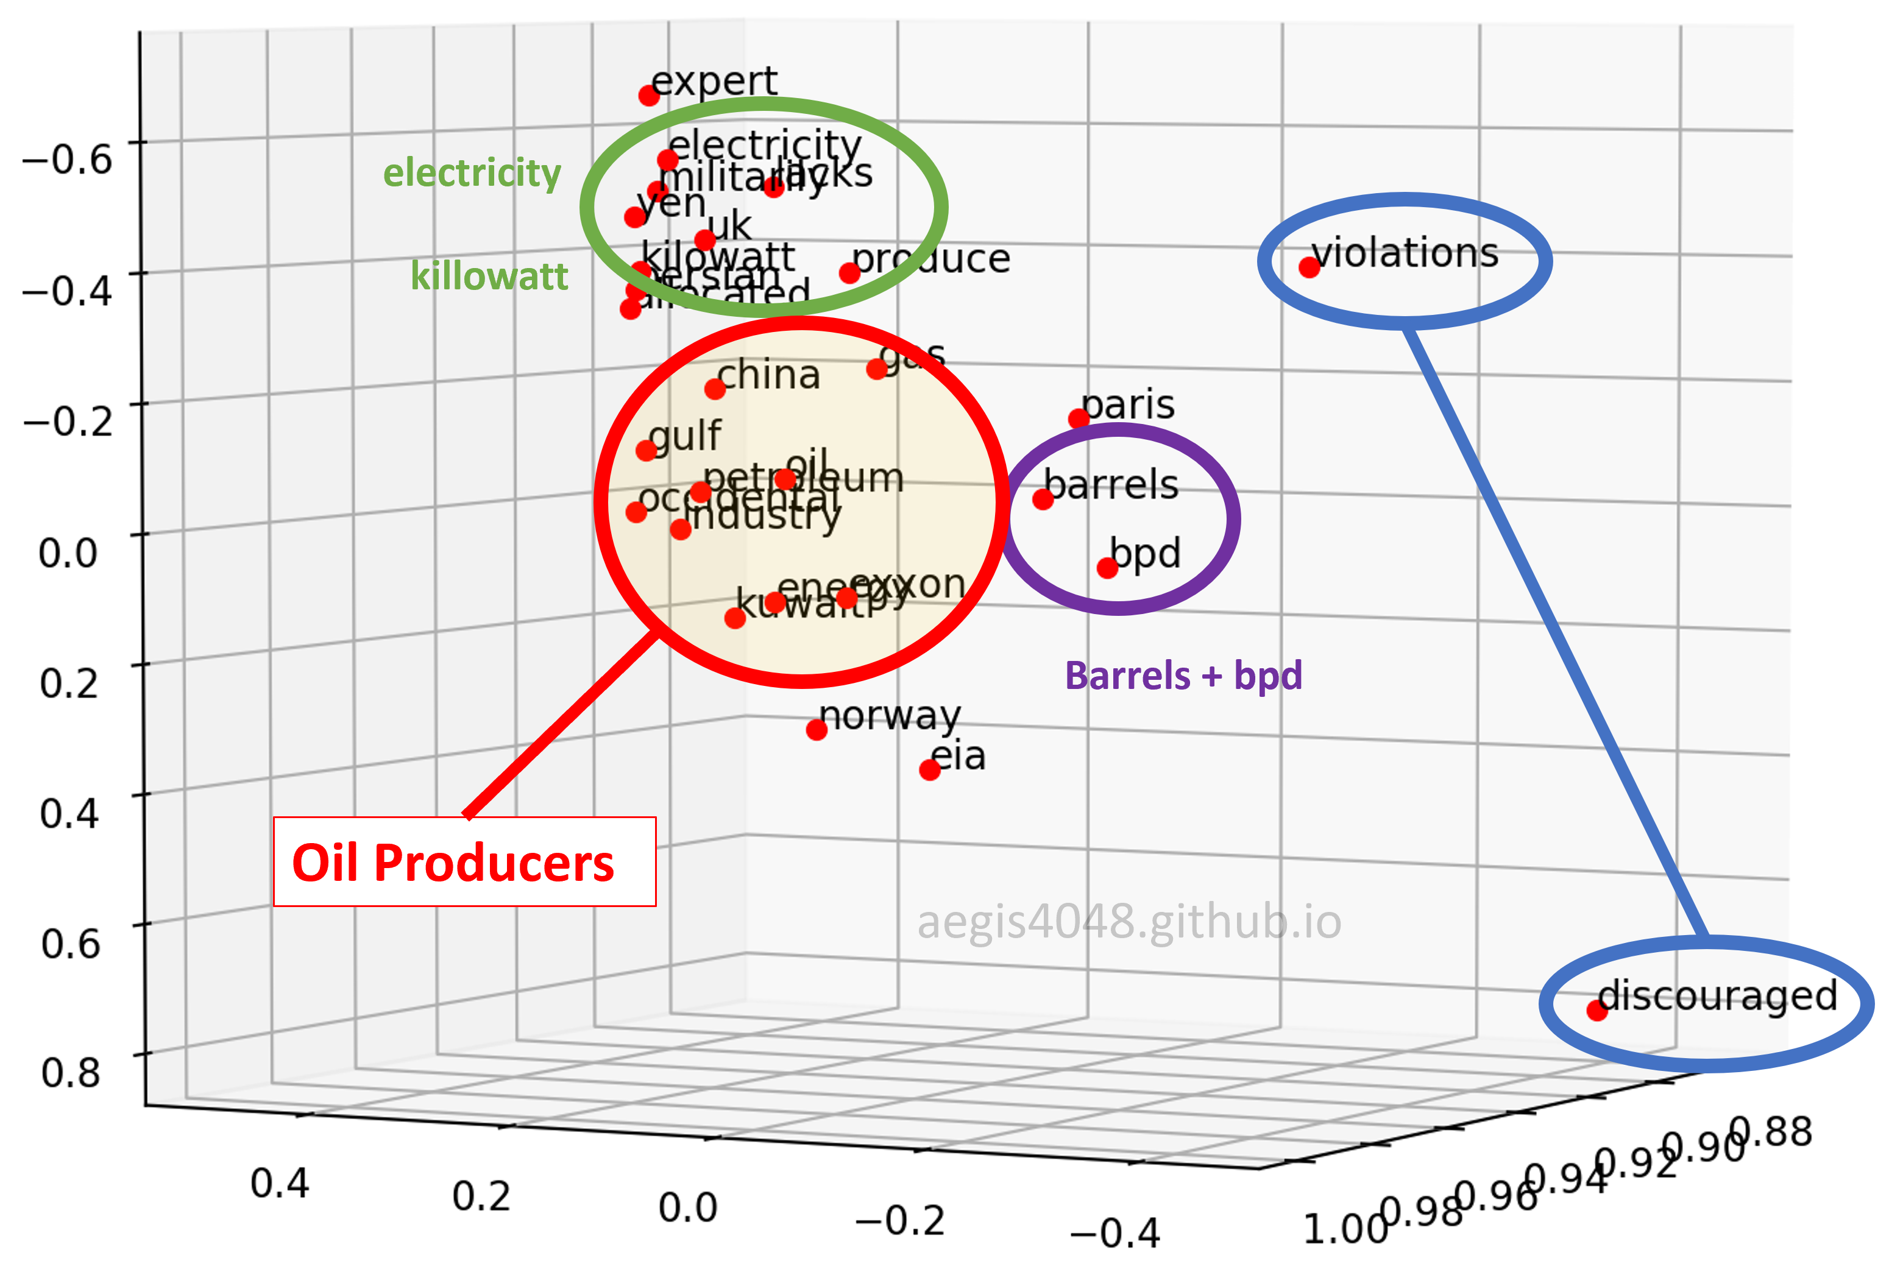
Vector Embeddings> Generative [GPT]
“Lebron James hit a tough shot.”
Vectors exist for the terms – vector for Lebron James, has commonalities with basketball, celebrity, & male in many dimensions simultaneously.

Slide 11
Generative [GPT]
The model uses the vector representations of concepts along generate new patterns.
Lebron
James
hit
a
difficult
tough
hard
LLMs build token by token to arrive at a response.

Slide 12
Generative [GPT]
The model uses the vector representations of concepts along generate new patterns.
Lebron
James
hit
a
tough
steak
shot
3-pointer
LLMs build token by token to arrive at a response.

Slide 13


Slide 14






NLP/TM Challenges - Disambiguation
I made her duck.
Speech to text:
“I see you’re up two nothing.”
I cooked waterfowl for her to eat.
I cooked waterfowl belonging to her.
I created the (clay?) duck and gave it to her.
Duck!!
Soccer match
I see you’re up to nothing [lazy]

Slide 15
NLP/TM Challenges
Other Challenges
Examples
Compound words (tokenization) change meaning
Sarcasm
Cultural differences
“Bad” vs “not bad”
“I like it…NOT!”
“It’s wicked good” (in Boston)

Slide 16

NLP is Art & Science
Challenges because human expression is diverse, often ambiguous, affected by age, demographics, socio-economics, medium/channel & regional attributes of the author.
Books
Electronic Docs (PDFs)
Blogs
Websites
Social Media
Customer Records
Customer Service Notes
Notes
Emails
Legal Documents
Research Papers
….
*AI Generated

Slide 17



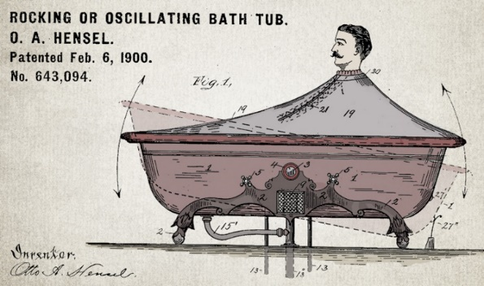

Channel affects language
🐝🔀🙏👁️👁️➡️🌎
Legal documents are verbose & technical.
“Be the change you want to see in the world.”
“kappa” indicates sarcasm, irony,
or a joke among online gamers.
Expression is context specific making analysis challenging.

Slide 18



Messenger affects language
Boomers 1946-1964
* Make a difference * Consensus/team * Experiment/try new things * “Imagine if…” * Save time * Features and benefits
Gen X 1965-1980
Best, finest, world-class
“You will benefit by…”
”This is in your best interest.”
Gen Y 1981-2000
Global citizen
Balance
Diversity
Community/connections
Beyond generation, other factors like socio-economic, gender & demographic makeup impact expression.
https://www.anneloehr.com/

Slide 19


Expression is evolving rapidly due to technology.
“Thank you, next.”
“Woke”
“Cray”
“Gucci”
“Squad goal”
“Bible…”
“Adulting”
“Turnt”
“Hundo P”
“Trill”
“TFW”
”Rizz”
Beyond generation, other factors like socio-economic, gender & demographic makeup impact expression.

Slide 20
Gen Y/Z expression is evolving rapidly due to technology.
“Thank you, next.” – moving on with positive connotation
“Woke” - The more woke one is, the more sympathetic & knowledgeable one is about a topic or type of person
“Cray” - crazy
“Gucci” – fine, good
“Squad goal” – friend group behavior
“Bible…” - what follows is TRUTH
“Adulting” – activities associated with growing up
“Turnt” – “turned up” i.e. really excited
“Hundo P” – agree “100%”
“Trill” – True & Real
“TFW” – “That Feeling When” to describe an emotion
“Rizz” – Short for Charisma
Beyond generation, other factors like socio-economic, gender & demographic makeup impact expression.

Slide 21




Audience affects language
And we all context switch based on who were are speaking too.

Slide 22
Key word scanning
Basic R Unix Commands
Setup
grepl returns a vector of T/F if the pattern is present at least once
grepl(“pattern”, searchable object, ignore.case=TRUE)

Slide 23
Key word scanning
Basic R Unix Commands
Setup
grepl returns a vector of T/F if the pattern is present at least once
grepl(“pattern”, searchable object, ignore.case=TRUE)
grep returns the position of the pattern in the document
grep(“pattern”, searchable object, ignore.case=TRUE)

Slide 24
Key word scanning
Basic R Unix Commands
Setup
grepl returns a vector of T/F if the pattern is present at least once
grepl(“pattern”, searchable object, ignore.case=TRUE)
grep returns the position of the pattern in the document
grep(“pattern”, searchable object, ignore.case=TRUE)
“library(stringi)” Functions
stri_count counts the number of patterns in a document
stri_count(searchable object, fixed=“pattern”)

Slide 25
Substitutions
Replace the first instance of a pattern
sub(“pattern”, replacement, x, ignore.case=TRUE)
text <- "this is some text, made of text characters”
sub('is', 'REPLACE',text)
[1] "thREPLACE is some text, made of text characters"

Slide 26
Substitutions
Replace the first instance of a pattern
sub(“pattern”, replacement, x, ignore.case=TRUE)
text <- "this is some text, made of text characters”
sub('is', 'REPLACE',text)
[1] "thREPLACE is some text, made of text characters"
Replace the all instances of a pattern
gsub(“pattern”, replacement, x, ignore.case=TRUE)
text <- "this is some text, made of text characters”
gsub('is', 'REPLACE',text)
[1] "thREPLACE REPLACE some text, made of text characters"

Slide 27
Let’s Practice!
Open C_Keyword_Scanning.R

Slide 28
Remember This?

Slide 29

R for Cleaning Steps
On XX/XX/23 I opened a Marcus Savings account with a promotion : \"\" After enrolling, you must deposit {$10000.00} or more in new funds from an external account into your Account within 10 calendar days of enrollment ( the Funding Period ). The Account…
gsub() substritutions
Remove URLs
Lower case
Remove specific words
Remove punctuation
Remove numbers
Strip whitespace
blogs
reviews
articles
redacteddate opened marcus savings promotion enrolling must deposit new funds external within calendar days enrollment funding period balance plus minimum new funds required dollar amount must maintained consecutive days end funding period balance…

Slide 30
Library TM Functions
VCorpus creates a corpus held in memory.
VCorpus(source)
tm_map applies the transformations for the cleaning
tm_map(corpus, function)
getTransformations() will list all standard tm corpus transformations. We can apply string functions from other packages with content_transformer(FUNCTION)
tm_map(corpus, removePunctuation) - removes punctuation from the documents
tm_map(corpus, stripWhitespace) - extra spaces, tabs are removed
tm_map(corpus, removeNumbers) - removes numbers
tm_map(corpus, content_transformer(tolower)) – makes all case lower
tm_map(corpus, removeWords) - removes specific “stopwords”
New Text Mining Concepts
Corpus- A collection of documents that analysis will be based on.
Stopwords – are common words that provide very little insight, often articles like “a”, “the”. Customizing them is sometimes key in order to extract valuable insights.
6/7/26
Kwartler
30

Slide 31
Custom Functions in E_Cleaning.R
“tryTolower” is poached to account for errors when making lowercase.
tryTolower <- function(x){
# return NA when there is an error
y = NA
# tryCatch error
try_error = tryCatch(tolower(x), error = function(e) e)
# if not an error
if (!inherits(try_error, 'error'))
y = tolower(x)
return(y)}
“clean.corpus” makes applying all transformations easier.
cleanCorpus<-function(corpus, customStopwords){
corpus <- tm_map(corpus, content_transformer(qdapRegex::rm_url))
corpus <- tm_map(corpus, content_transformer(tryTolower))
corpus <- tm_map(corpus, removeWords, customStopwords)
corpus <- tm_map(corpus, removePunctuation)
corpus <- tm_map(corpus, removeNumbers)
corpus <- tm_map(corpus, stripWhitespace)
return(corpus)
}

Slide 32
Nuances & Inputs for Setting Up a TM Project
“custom.stopwords” combines vectors of words to remove from the corpus
#Create custom stop words
customStopwords <- c(stopwords('english'), 'bank', 'money', 'account')
Add channel specific stop words.
E.g. slang & abbreviations

Slide 33
Nuances & Inputs for Setting Up a TM Project
“custom.stopwords” combines vectors of words to remove from the corpus
#Create custom stop words
customStopwords <- c(stopwords('english'), 'bank', 'money', 'account')
Loading data
# Data
text <- read.csv(‘https://raw.githubusercontent.com/kwartler/teaching-datasets/refs/heads/main/allComplaints.csv’)
text$Consumer.complaint.narrative[1]

Slide 34
Nuances & Inputs for Setting Up a TM Project
Performing substitutions (optional)
text$Consumer.complaint.narrative <- gsub('X+’,
'REDACTED’,
text$Consumer.complaint.narrative)

Slide 35
Nuances & Inputs for Setting Up a TM Project
Performing substitutions (optional)
text$Consumer.complaint.narrative <- gsub('X+’,
'REDACTED’,
text$Consumer.complaint.narrative)
Create a Corpus
# Corpus Object
txtCorpus <- VCorpus(VectorSource(text$Consumer.complaint.narrative))
text$Consumer.complaint.narrative[1]

Slide 36
Nuances & Inputs for Setting Up a TM Project
Performing substitutions (optional)
text$Consumer.complaint.narrative <- gsub('X+’,
'REDACTED’,
text$Consumer.complaint.narrative)
Create a Corpus
# Corpus Object
txtCorpus <- VCorpus(VectorSource(text$Consumer.complaint.narrative))
text$Consumer.complaint.narrative[1]
Clean the corpus
txtCorpus <- cleanCorpus(txtCorpus, customStopwords)

Slide 37
For Bag of Words, how is data organized?
Document Term Matrix
 | Term1 | Term2 | Term3 | … | Term_n
Document | 1 | 1 | 1 | 0 | 0
Document | 0 | 1 | 0 | 0 | 0
Document | 3 | 0 | 0 | 3 | 0
… | 0 | 0 | 0 | 1 | 1
Document_n | 0 | 0 | 0 | 1 | 0
Code to Create the DTM/TDM and change to a matrix
Why are DTM & TDM Sparse? What do they represent?
txtDtm<-DocumentTermMatrix(txtCorpus)
txtDtmM<-as.matrix(txtDtm)
??
The matrices are sparse (many 0’s) so additional steps may be needed to extract information.

Slide 38
Open D_Cleaning.R

Slide 39
Summarizing the DTM
termFreq <-???????(txtDtmM)
termFreq <- data.frame(word = names(termFreq),
frequency = termFreq,
row.names = NULL)
Document Term Matrix
Word Frequency Matrix
 | Term1 | Term2 | Term3 | … | Term_n
Document | 0 | 1 | 1 | 0 | 0
Document2 | 0 | 1 | 0 | 0 | 0
Document3 | 0 | 0 | 0 | 3 | 0
… | 0 | 0 | 0 | 1 | 1
Document_n | 1 | 0 | 0 | 1 | 0
word | freq
Term1 | 1
Term2 | 2
Term3 | 3
… | 5
Term_n | 2
Can anyone think of how you could get a DTM to be a WFM?

Slide 40
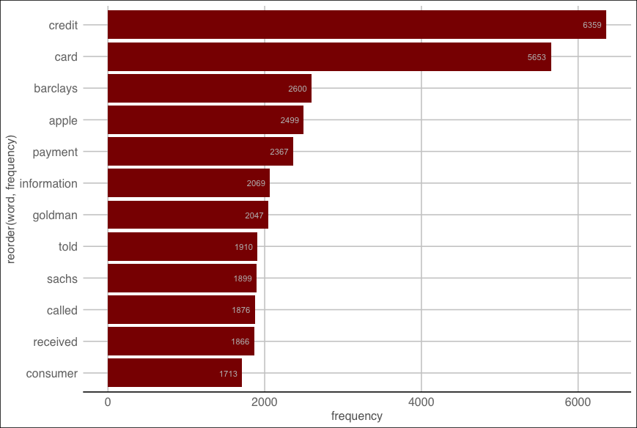
Open E_Frequency.R to visualize the WFM

Slide 41
Let’s explore specific & frequent terms

Slide 42
Word Association
# Inspect word associations
associations <- findAssocs(txtDtm, c('called'), 0.3)
associations
# Organize the word associations
assocDF <- data.frame(terms = names(associations[[1]]),
value = unlist(associations),
row.names = NULL)
Word Association is similar to correlation. When word A appears, how often does word B? Unlike correlation, terms can only be positively associated. This is because there are so many terms that everything word not in the corpus would be “negatively correlated (associated). It is the % of time a word shows up in a document with another word.

Slide 43
Word Association
# Chg to factor so bars are ordered by value not alphabetical
assocDF$terms <- factor(assocDF$terms, levels=assocDF$terms)
assocDF
# Make a dot plot
ggplot(assocDF, aes(x=value, y=reorder(terms,value))) +
geom_point(col='#c00c00') +
theme_gdocs() +
geom_text(aes(x=value,label=value), colour="#c00c00",hjust="inward", vjust ="inward" )

Slide 44
Back to E_Frequency.R

Slide 45
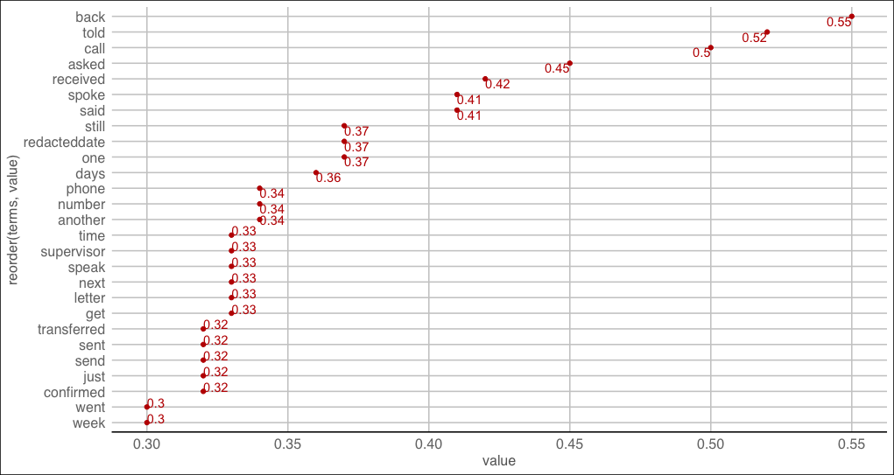
“called” word Association
Back, told, call, asked
"When my financial hardship began I contacted my lender Marcus by Goldman Sachs in REDACTED 2022 to inform them that Im having difficulty making the full payment and can I request a hardship or assistance plan? I was informed by their rep. NO i dont qualify. It bothered me because another lender company I applied at the same time worked with me and I have no problems and I'm currently back making my regular monthly payments with that lending company. But Marcus has been a complete opposite and nightmare. The numerous calls through my day. This company called over 15 times in a day and everyday but sunday. It was so horrible that I had to cut my phone off because they called so much. Plus the letters about the loan to make it seem as if I was not contacting them to work something out. I reached out again in REDACTED, REDACTED, REDACTED, and in REDACTED. just to see if I qualify and again all four times their Rep told me no about a payment ..."

